Slide 1
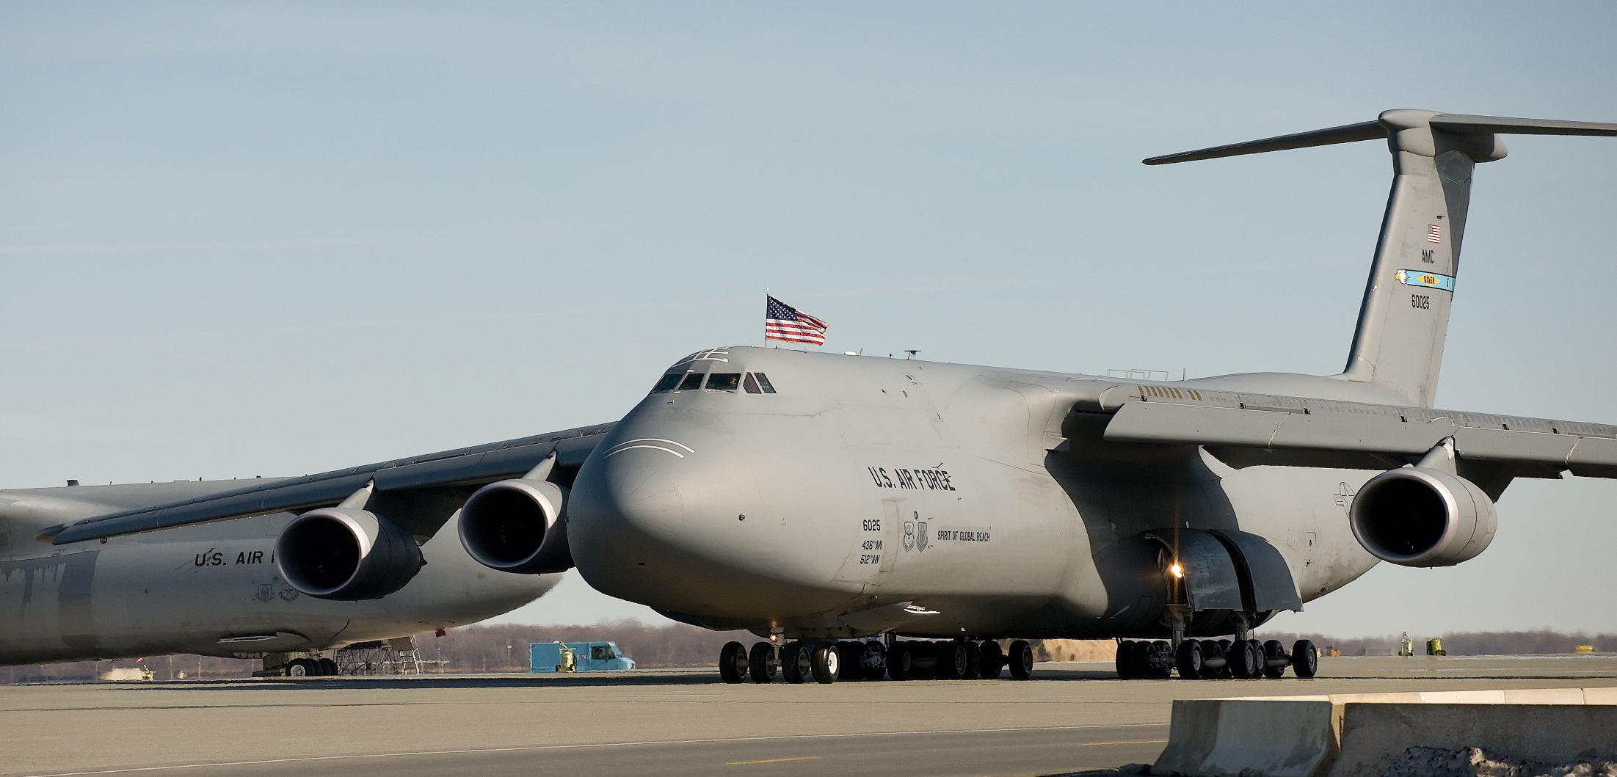
Pic of a C-5 in case you need it

Slide 2
PIWG Action Item XX-XXX
Title:
Opened: WUC:
P/N: NSN:
Tech Data:
Initiator: (Name and Office Symbol)
Action Officer: (Name and Office Symbol)
Current Status:
Status Recommendation: (Keep Open or Close)
Historical Milestones
Milestone Schedule
Problem Background
Technical Recommendation
Notes:
STATUS RECOMMENDATION:
OPEN – INVESTIGATION IN WORK (OIIW) OPEN – INVESTIGATION IN WORK (OIIW)
OPEN – AWAITING FUNDS (O-AF) OPEN – AWAITING FUNDS (O-AF)
OPEN – AWAITING FIX VERIFICATION (O-FIX) OPEN – AWAITING FIX VERIFICATION (O-FIX)
OPEN – IN DISPUTE (DISPUTE) OPEN – IN DISPUTE (DISPUTE)
CLOSE – ACCEPTABLE RISK (C-AR)
CLOSE – ADMINISTRATIVELY (C-ADMIN)
CLOSE – INVESTIGATION COMPLETE (C-IC)
CLOSE – CORRECTED & VERIFIED (C-CV)
IF PARENT DR: LIST ALL CHILD DR RCNS

